Slide 1
Spring Boot

Slide 2
Spring Boot is a platform that simplifies the creation of create stand-alone, production-gradeSpring based Applications that you can "just run".
Spring Boot applications need very little Spring configuration.

Slide 3
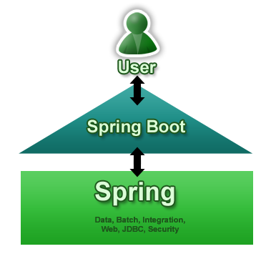
Create stand-alone Spring applications
Embed Tomcat, Jetty or Undertow directly (no need to deploy WAR files)
Provide opinionated 'starter' POMs to simplify your Maven configuration
Automatically configure Spring whenever possible
Provide production-ready features such as metrics, health checks and externalized configuration
Absolutely configuring the dependencies for building the enterprise applications

Slide 4
Features
Comes with an inbuilt Servlet Containers Support
Starter POMs :
reduces the burden of searching and configuring all the dependencies required for a framework
For example, in a project that uses Spring Batch for batch processing, you just have to include spring-boot-starter-batch that will import all the required dependencies for the Spring Batch application.
Template Engines Support :
Template engines are tools to separate program-logic and presentation into two independent parts. spring boot will automatically pick the templates from src/main/resources/templates.
It is good practice to avoid using JSP for the templates as it has lot of limitations using with embedded servlet containers.

Slide 5
Starting with a Spring Boot Application
@EnableAutoConfiguration :class-level annotation to find the beans that are necessary to run the application by looking at the classpath
This annotation tells Spring Boot to “guess” how you will want to configure Spring, based on the jar dependencies that you have added. If spring-boot-starter-web added Tomcat and Spring MVC, the auto-configuration will assume that you are developing a web application and setup Spring accordingly.
SpringApplication.run() :SpringApplication class is used for bootstrap and launch spring application. The bootstrap of an spring application consists of creating appropriate application context, loading beans, trigger any command line beans
SpringBootServletInitializer :is required to run the web application. This will enable the servlet container and bind your application to the servlet container.

Slide 6
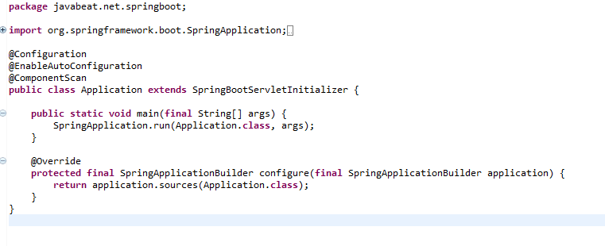

Slide 7
Maven configurations
Spring Boot is compatible with Apache Maven 3.2 or above.
spring-boot-starter-* :Starter POM’s are pre-defined POM’s descriptors that are available as in-built. You need not search for the dependencies and configure it.
For example, if you want to get started using Spring and JPA for database access, just include the spring-boot-starter-data-jpa dependency in your project
spring-boot-starter-parent: is a special starter that provides useful Maven defaults.
spring-boot-maven-plugin :This plug-in allows you to package your application into an executable JAR or WAR file. This is supported from Maven 3.2 on wards.

Slide 8
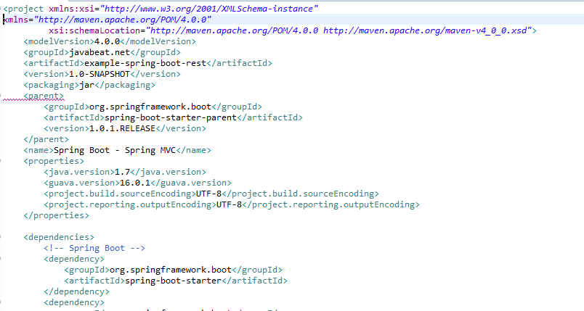

Slide 9
Deploying to the cloud
Spring Boot’s executable jars are ready-made for cloud PaaS (platform-as-a-service) providers.
These providers need some intermediary layer that adapts your application to the cloud’s notion of a running process.
Two popular cloud providers, Heroku and Cloud Foundry, employ a “buildpack” approach. The buildpack wraps your deployed code in whatever is needed to start your application: be it a JDK and a call to java, or an embedded web server, or a full-fledged application server.
A buildpack is customizable; but not advised. This reduces the footprint of functionality that is not under your control. It minimizes divergence between development and production environments.
Ideally, your application, like a Spring Boot executable jar, has everything that it needs to run packaged within it.

Slide 10
Cloud Foundry
Cloud Foundry provides default buildpacks that come into play if no other buildpack is specified. The Cloud Foundry Java buildpack has excellent support for Spring applications, including Spring Boot. You can deploy stand-alone executable jar applications, as well as traditional .war packaged applications.
Once you’ve built your application (using, for example, mvn clean package) and installed the cf command line tool, simply deploy your application using thecf push command as follows, substituting the path to your compiled .jar. Be sure to have logged in with your cf command line client before pushing an application.
$ cf push acloudyspringtime -p target/demo-0.0.1-SNAPSHOT.jarSee the cf push documentation for more options. If there is a Cloud Foundry manifest.yml file present in the same directory, it will be consulted.

Slide 11
To deploy a Spring Boot application in Eclipse, users need only drag and drop their application project to a PWS target created by Cloud Foundry Eclipse, a joint tooling collaboration between Pivotal Software, Inc. and IBM.
The Cloud Foundry runtime setup, application deployment and startup, and creation of services used by the application like an SQL database, are all taken care of for the user by the tooling and Cloud Foundry.
Application scaling is also easily performed, and project changes can be incrementally pushed through the Cloud Foundry Eclipse UI . This allows for smooth deployment and management of an application from the same Eclipse environment where the application is developed.

Slide 12
Binding to services
By default, metadata about the running application as well as service connection information is exposed to the application as environment variables (for example:$VCAP_SERVICES). This architecture decision is due to Cloud Foundry’s polyglot (any language and platform can be supported as a buildpack) nature; process-scoped environment variables are language agnostic.
Environment variables don’t always make for the easiest API so Spring Boot automatically extracts them and flattens the data into properties that can be accessed through Spring’s Environment abstraction:
@Component
class MyBean implements EnvironmentAware {
private String instanceId;
@Override
public void setEnvironment(Environment environment)
{
this.instanceId = environment.getProperty("vcap.application.instance_id"); } // ...
}
All Cloud Foundry properties are prefixed with vcap. You can use vcap properties to access application information (such as the public URL of the application) and service information (such as database credentials).

Slide 13
Installing Spring Boot applications
Generate ‘fully executable’ jars from your build,not a custom embeddedLaunchScript
To create a ‘fully executable’ jar with Maven use the following plugin configuration:
<plugin>
<groupId>org.springframework.boot</groupId>
<artifactId>spring-boot-maven-plugin</artifactId>
<configuration>
<executable>true</executable>
</configuration>
</plugin>

